Slide 1
Efficient XML Parsing and Database Integration Project
Sai Sumanth Boddu - Y00859727
Manju Madala - Y00857071

Slide 2
Introduction
The project involves combining data and implementing it for quick and easy access.
By reading multiple XML files, the project is able to present the information in a user-friendly, tabular format. The extraction, transformation, and loading process is completed in a minimal amount of time, allowing for fast generation of information.
This project is designed to provide users with easy access to information via the web, with data ready to read on a single click.
Note: port is localhost

Slide 3
Abstract
This project aims to efficiently parse XML files and directly create tables on a database.
The performance of the extraction, transformation, and loading (ETL) process is a key consideration to ensure that the project is both efficient and user-friendly.
The resulting database will then be used to display information about specific data, utilizing a session-based approach to provide a personalized and tailored experience for the user.
By leveraging the power of XML parsing and database technology, this project seeks to provide a seamless and intuitive platform for accessing and displaying information.

Slide 4
Languages
The below languages are used for the project implementation:
● Python
● Node.js
● Html
● CSS
● XML
● SQL (Query Language)

Slide 5
Dependencies, libraries, Modules
The below dependencies and modules are used for the project implementation:
● Morgan
● Mysql
● MariaDB
● Mustache
● handlebars
● express- handlebars
node Js
The below libraries used for the project implementation:
● os
● mysql.connector
● error
● xml.etree.ElementTree

Slide 6
Software/ application used
● VS Code editor
● php/myadmin
● Node JS
● MySQL
● Chrome
● Github

Slide 7
Data Set
● Data set is an XML file that contains information about awards distributed in a particular year from the National Science Foundation
https://www.nsf.gov/awardsearch/download.jsp

Slide 8
Algorithm
The algorithm used in this project is:
● Check if tables exist in the database based on XML parent and child elements and create them if necessary.
● Check for duplicate columns in the tables.
● Insert data into the tables, while checking for duplicate entries based on the award/data.
● Connect to the database server, which in this case is assumed to be running on localhost.
● Retrieve data from the database and store it in a session.
● Display information about a particular data/award based on the data stored in the session.

Slide 9
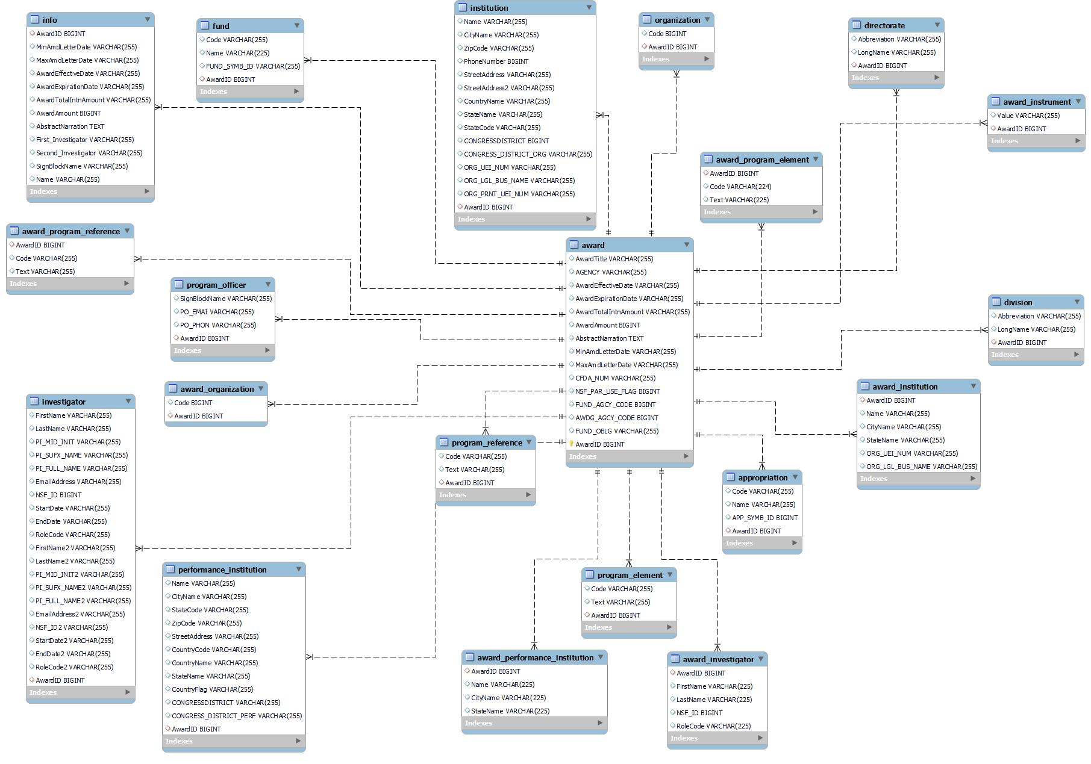
Relation and normalization(ER Diagram)

Slide 10
Methodology
Our project adopts a systematic approach to address the challenges associated with XML parsing and database integration:
Research and Familiarization:
Thorough understanding of XML structure and best practices.
Researching efficient XML parsing libraries and database integration techniques.
XML Parsing and Data Extraction:
Development of a robust parsing module using Python's xml.etree.ElementTree library.
Ensuring compliance with the provided XML schema to accurately parse the XML data.

Slide 11
Methodology
Database Integration:
Utilization of MySQL/MariaDB for database management.
Dynamic creation of database tables based on the extracted information.
User Interface Development:
Creation of a user-friendly web interface using HTML, CSS, and JavaScript.
Facilitating user interaction with the system, including file uploads and data visualization.
Performance Optimization and Testing:
Rigorous testing, including unit testing, integration testing, and performance testing.
Implementation of performance optimization techniques to enhance system scalability and responsiveness.

Slide 12
Learning Experiences
The below things were learned during the implementation of the project
● It helped to understand the concept of data interpretation learning.
● It helped me to learn different libraries in Python and to develop the concept and algorithm behind workflow.
● Understanding the concept of ETL (Extract, Transform, Load) and data cleaning, which are essential for data integration and preparation.
● Learning about data redundancy reduction and relationships between tables, which are important concepts for database design and optimization.
● Understanding the concept of data interpretation learning, which can help with making sense of data and deriving insights.

Slide 13
Experiments
In our project, we conducted the following experiments:
Researched best practices for XML parsing and database integration to ensure optimal performance and scalability.
Developed XML parsing module using Python's xml.etree.ElementTree library.
Integrated parsed data into MySQL/MariaDB for efficient storage and retrieval.
Conducted rigorous testing to identify and address any potential issues or bottlenecks.
Implemented performance optimization techniques such as parallel processing, batch processing, and database indexing to enhance system efficiency and responsiveness.

Slide 14
Discussion
Our project has made significant progress in achieving its objectives.
We successfully completed all milestones and addressed various challenges encountered along the way.
We have developed a robust system for parsing XML data and integrating it into a MySQL database.
However, we also faced some performance optimization challenges and delays in frontend development (if applicable), which we are actively working to address.
The system is capable of efficiently extracting, storing, and accessing valuable information from the NSF award data repository, thereby facilitating research, analysis, and decision-making. We are confident that with further refinement and optimization, our system will meet the needs of users.

Slide 15
Contribution
Sai Sumanth Boddu
Led XML parsing module development using Python.
Contributed to database integration and performance optimization.
Assisted in project planning and research.
Manju Madala:
Led backend development using Node.js and Express.js (if applicable).
Contributed to database schema design and testing.
Assisted in front-end development and user interface design (if applicable).

Slide 16
Conclusion
In conclusion, our project has demonstrated the feasibility and importance of efficient XML parsing and database integration for accessing and analyzing valuable data from the NSF award data repository.
We are confident that our system will facilitate easier access to valuable information for researchers and organizations, thereby contributing to advancements in science and engineering.
We extend our appreciation to our team members, faculty coach, and everyone who contributed to the success of this project. Together, we have achieved our goals and made a meaningful contribution to the field.

Slide 17
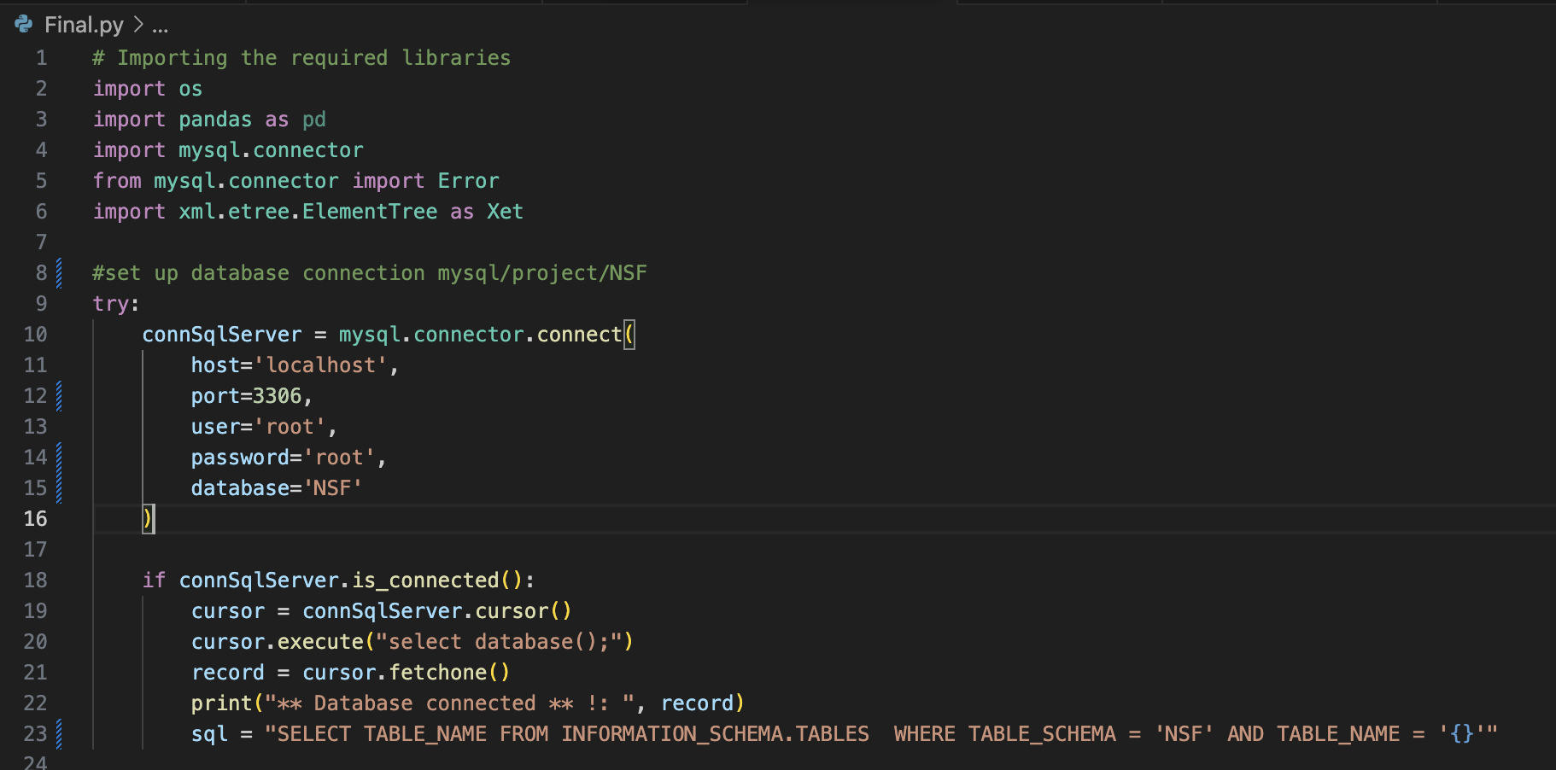
Implementation
Getting the libraries and establishing database connection

Slide 18
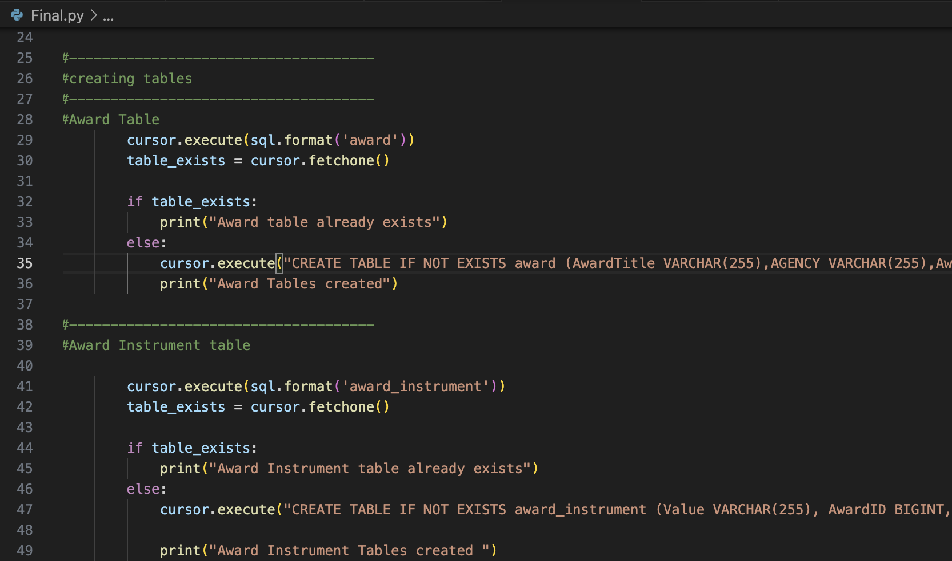
Implementation
Table creation using sql in python and parse the xml element using etree.ElementTree.parse() :

Slide 19
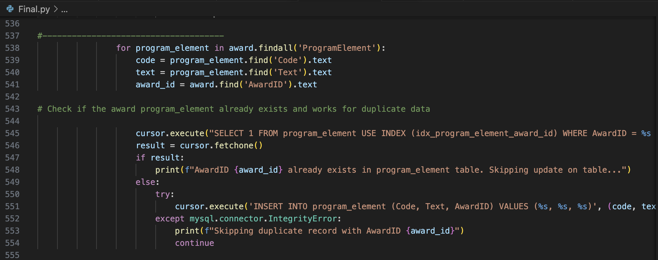
Implementation

Slide 20
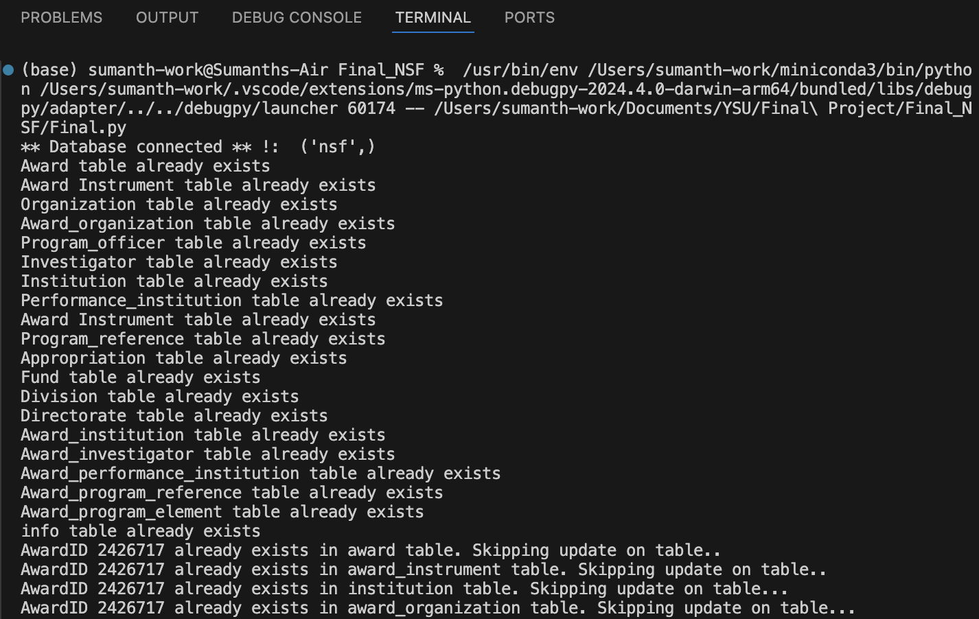
Implementation
Tables created and also detected if there is duplicate data and prevents that from insertion:

Slide 21
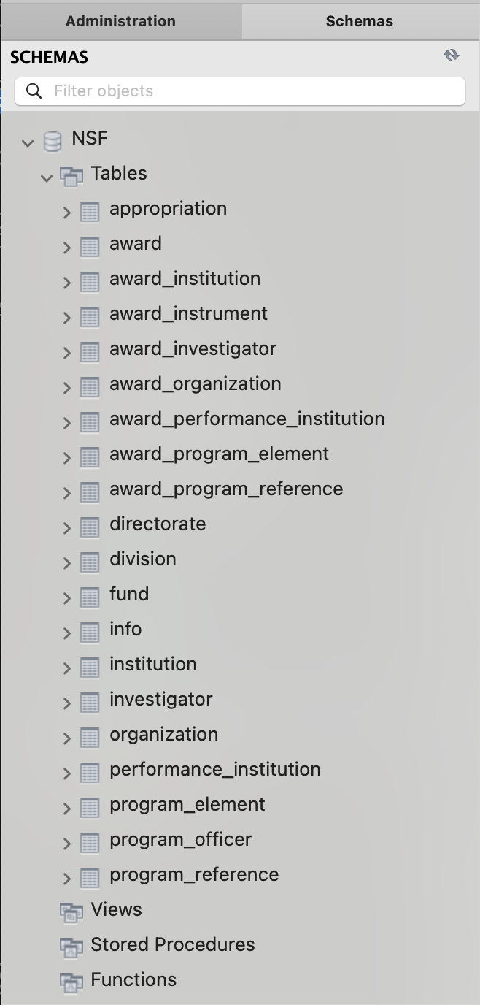
Implementation
Tables created:

Slide 22
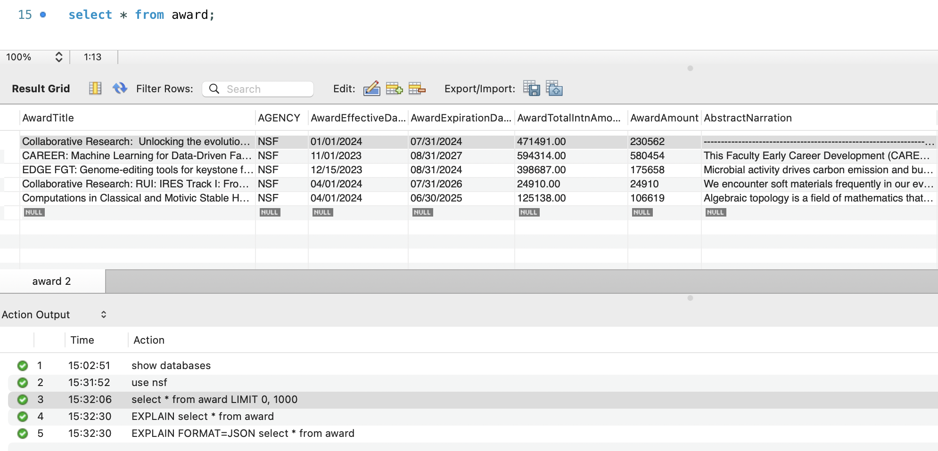
Implementation
Data inserted:

Slide 23
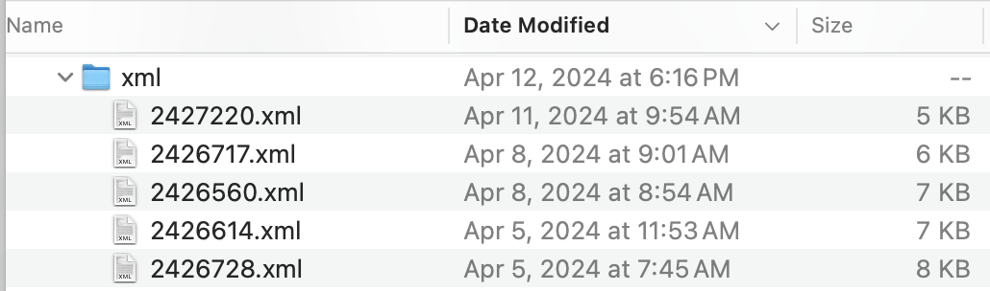
Implementation
XML Data collection with a duplicate file

Slide 24
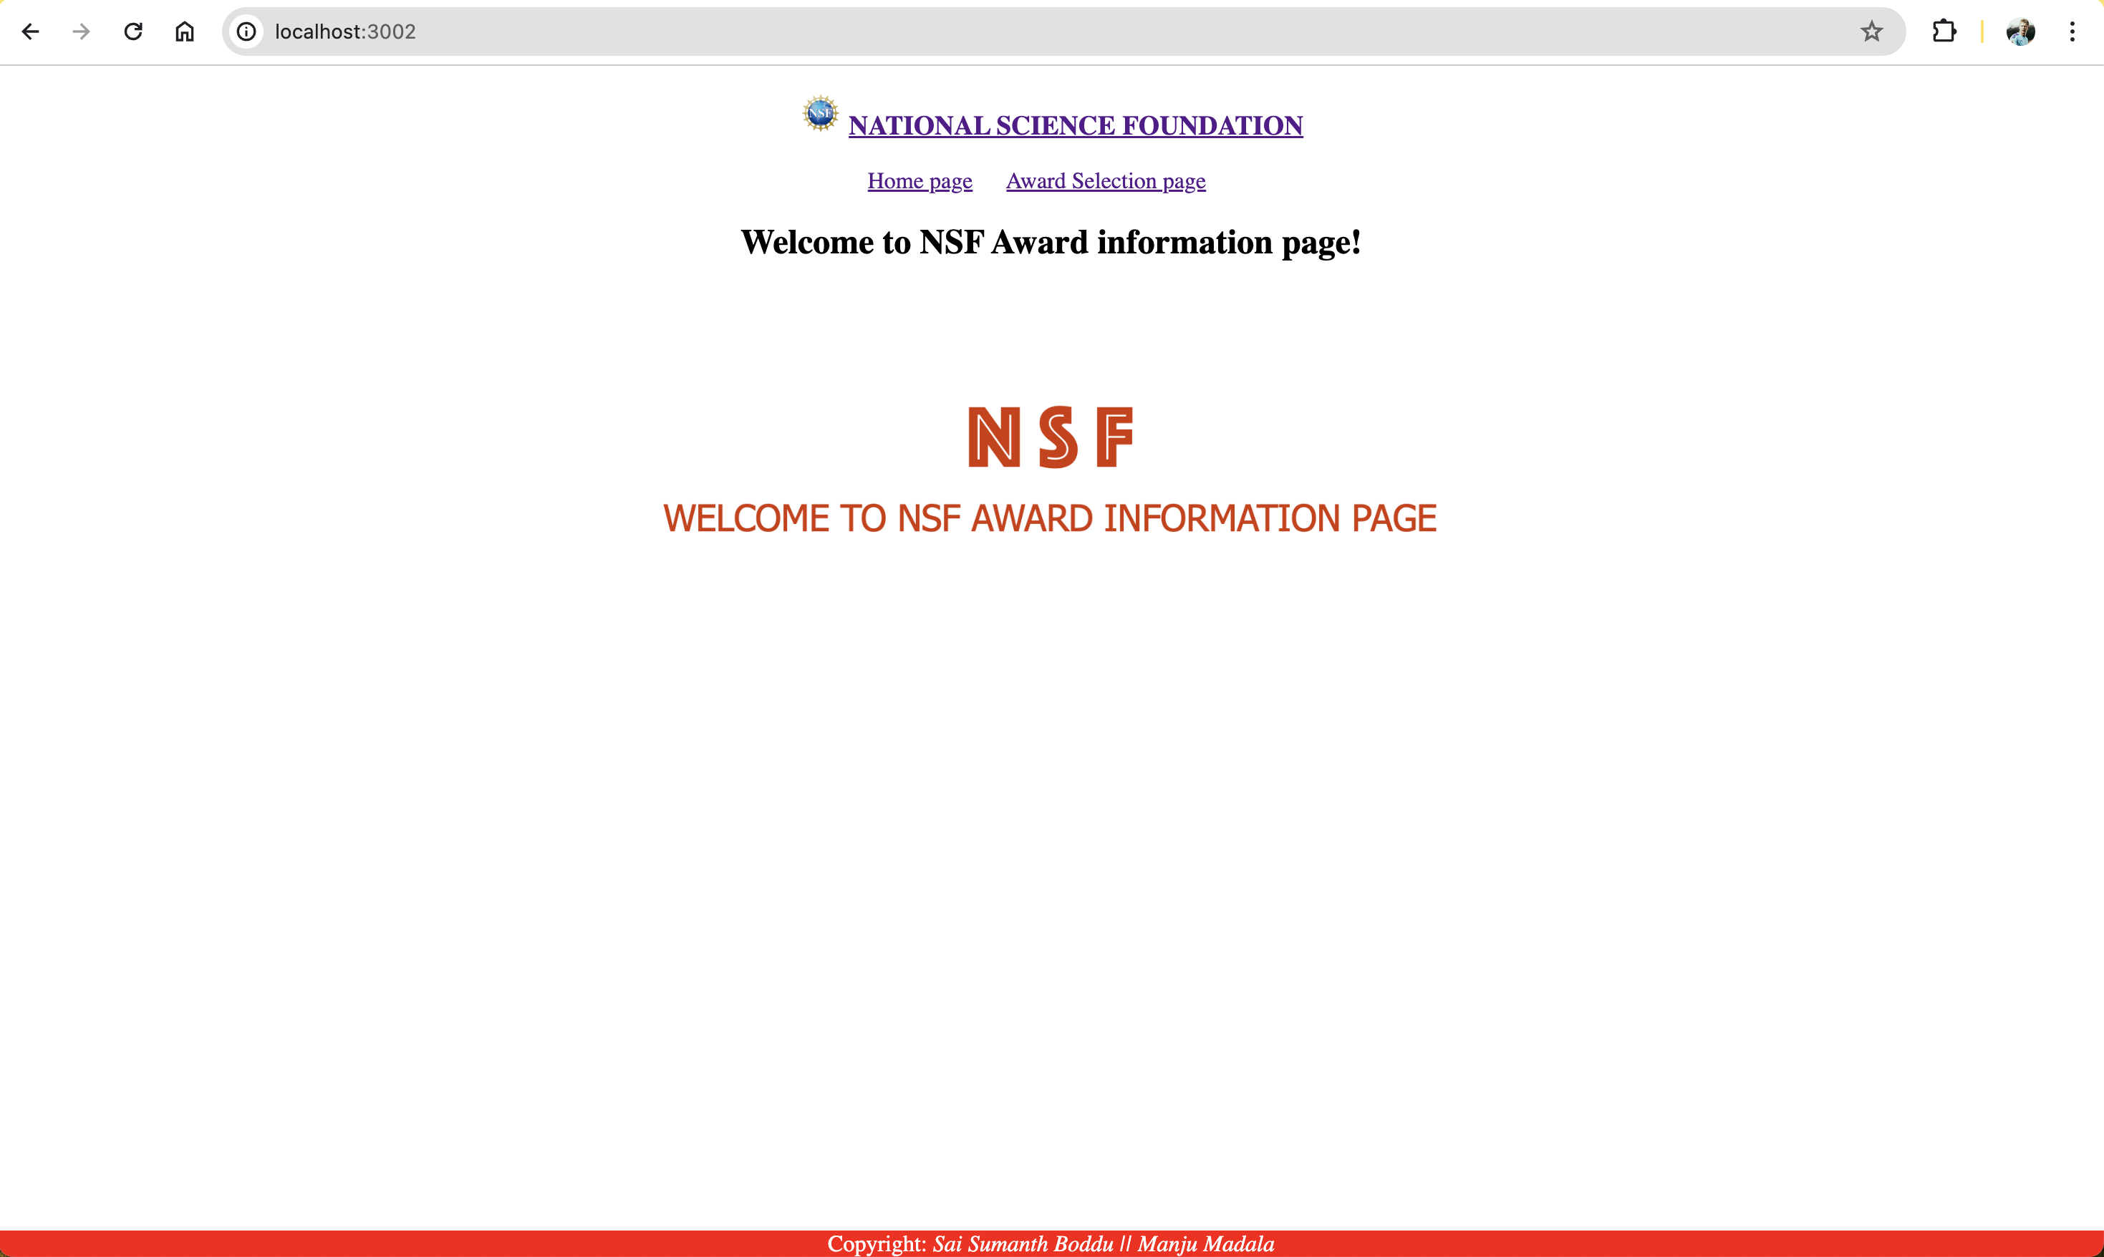
Implementation
Home Screen

Slide 25
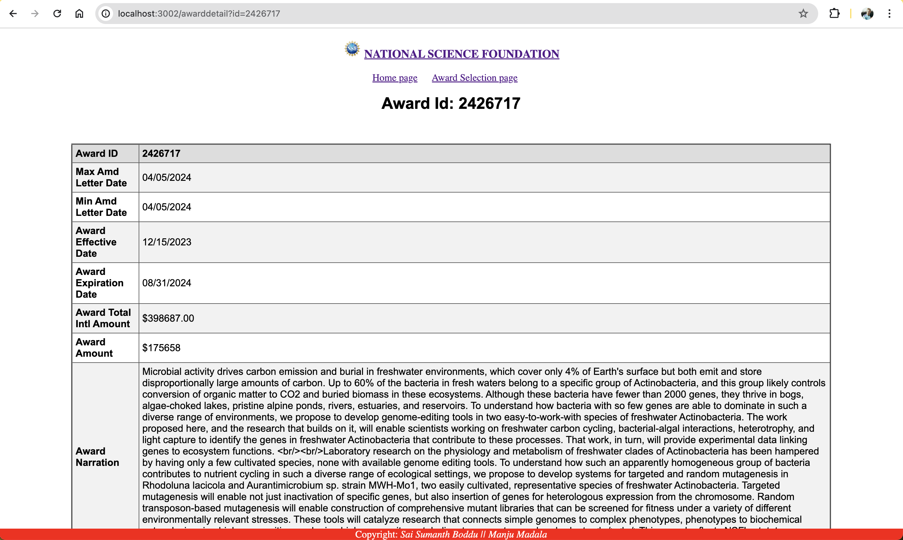
Implementation
Award Information

Slide 26
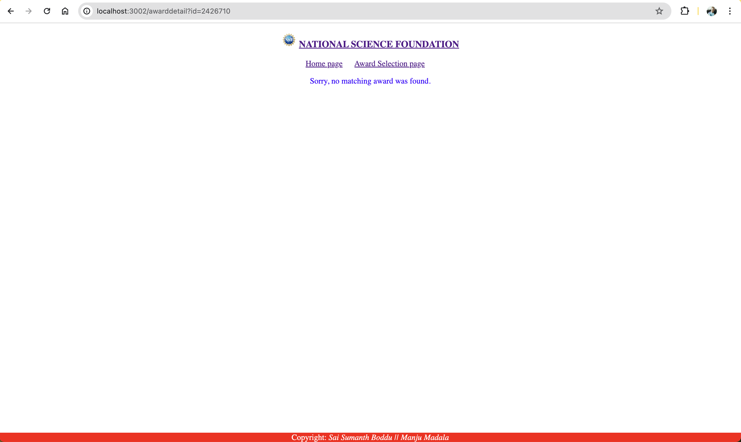
Implementation
If Award Information is not found

Slide 27
Thank You

